Slide 1
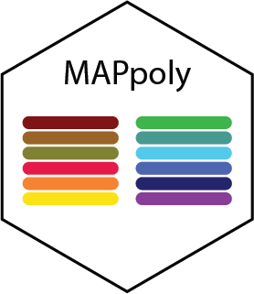
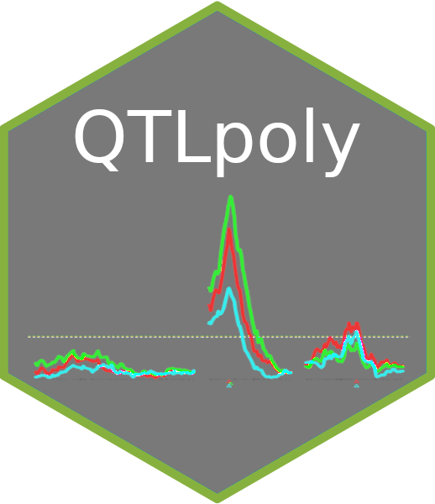

MAPpoly and QTLpoly updates
Marcelo Mollinari
Gabriel Gesteira
Guilherme Pereira
Zhao-Bang Zeng

Slide 2
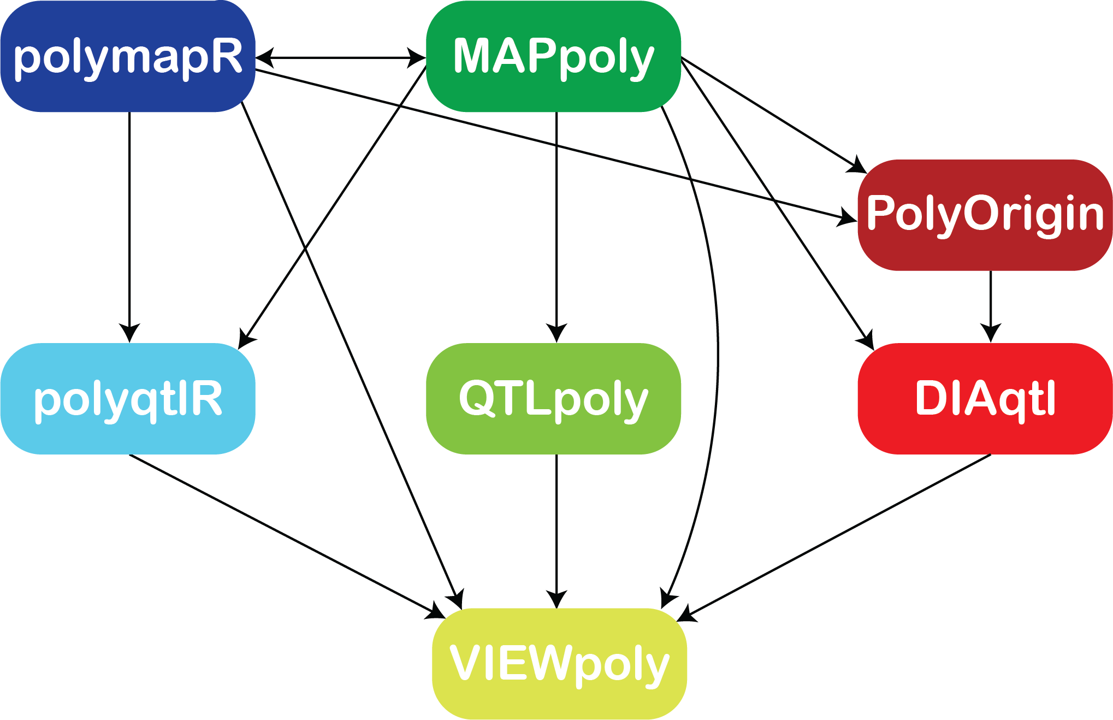
Analytical environment for linkage and QTL mapping in polyploids

Slide 3
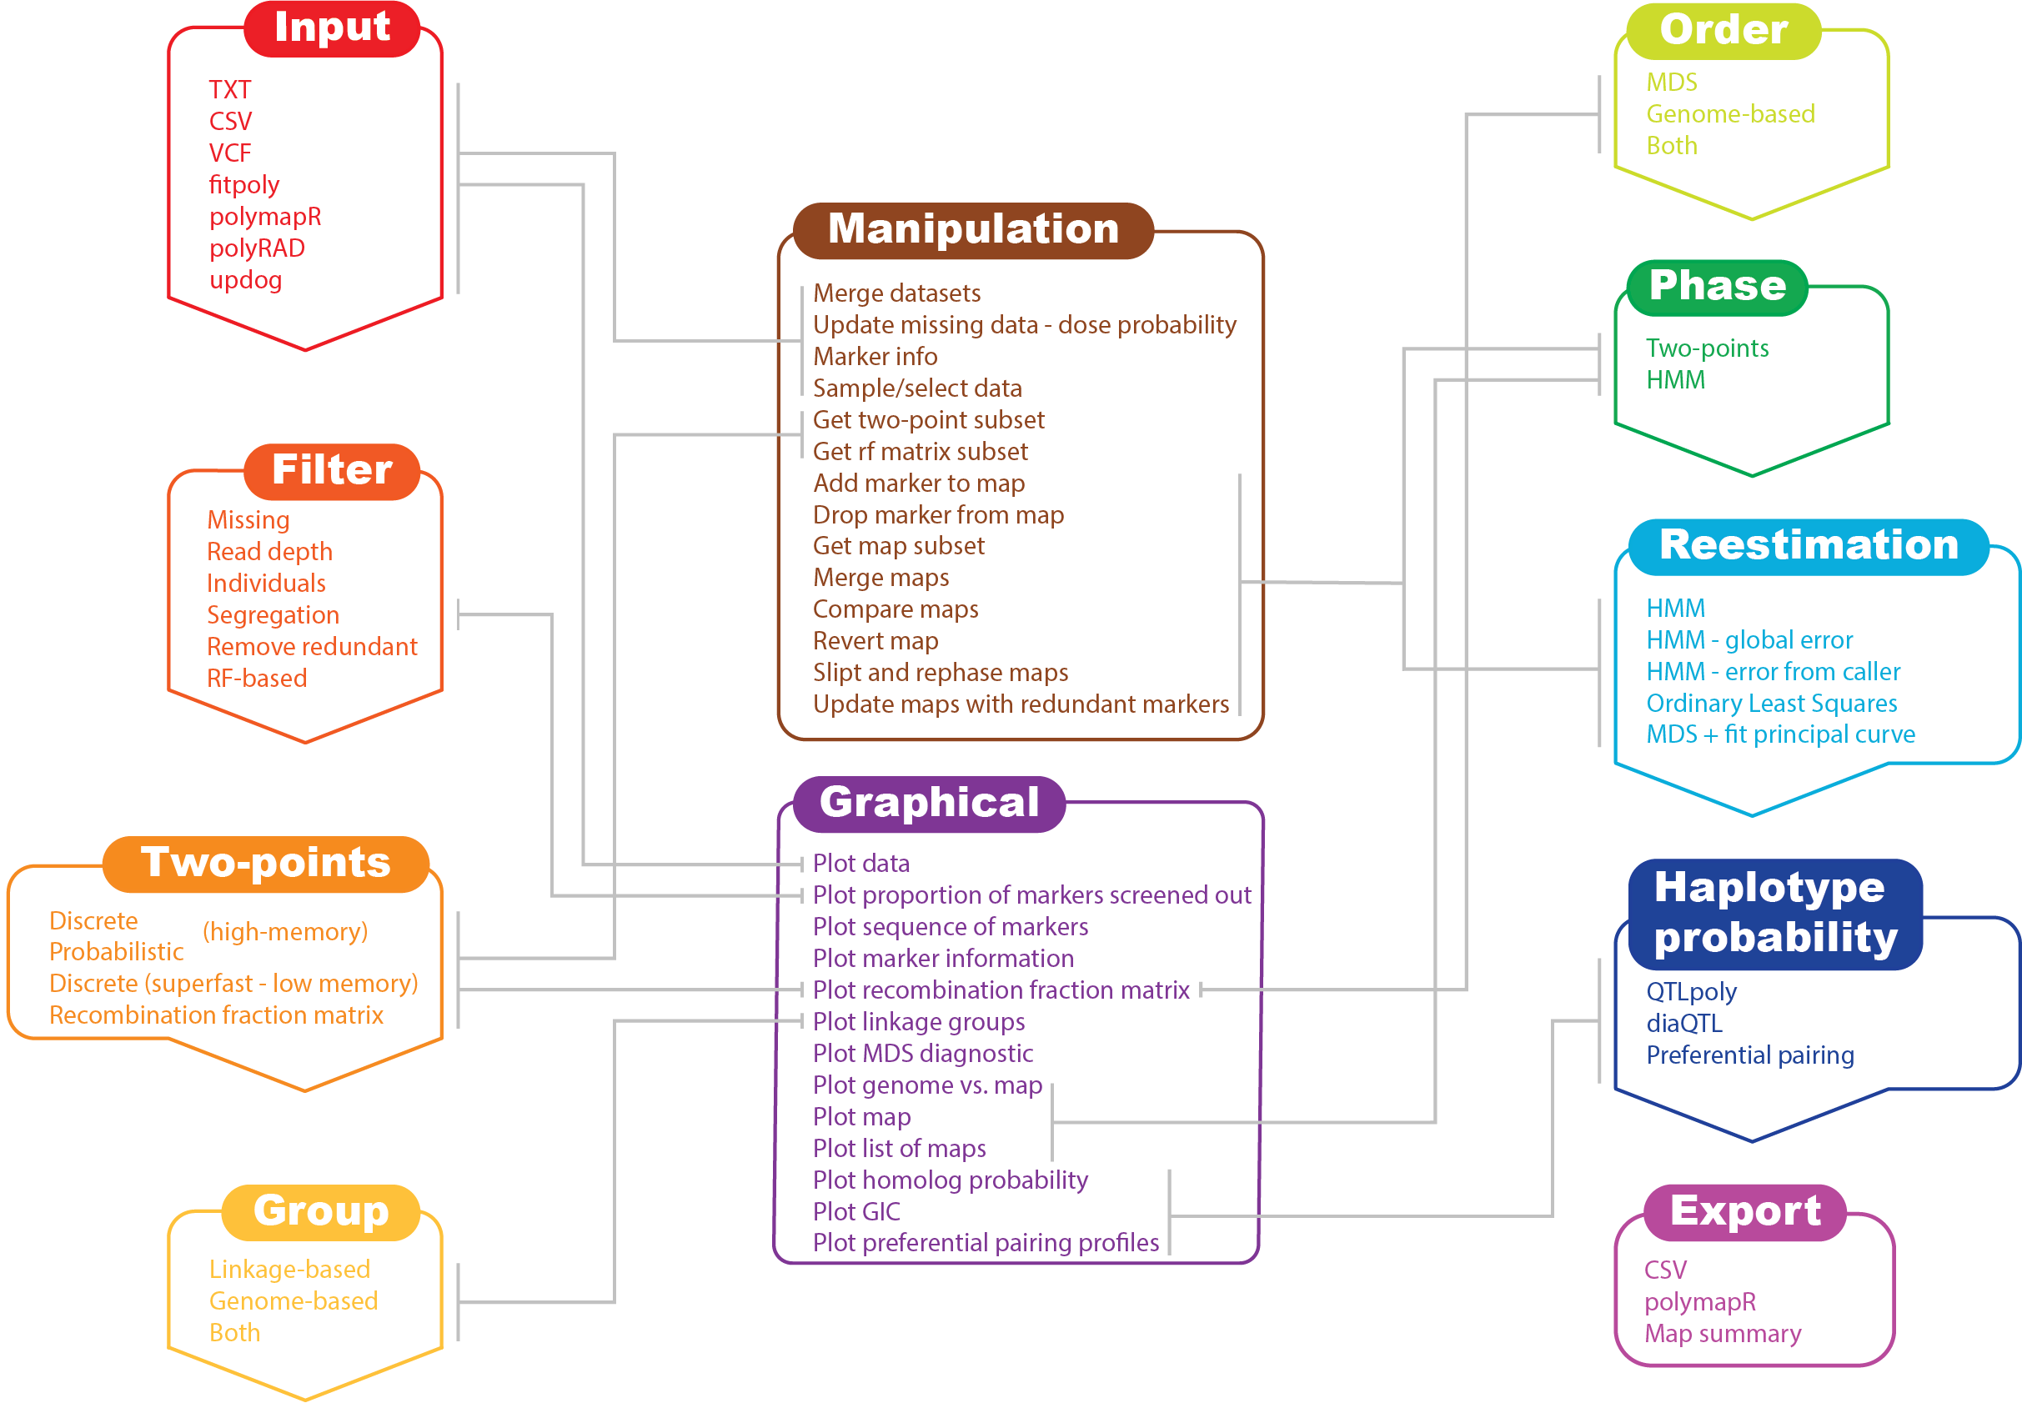
MAPpoly workflow

Slide 4
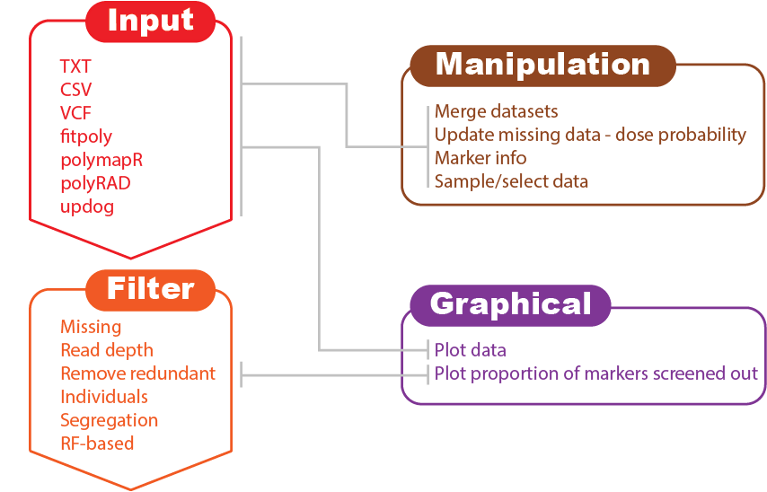
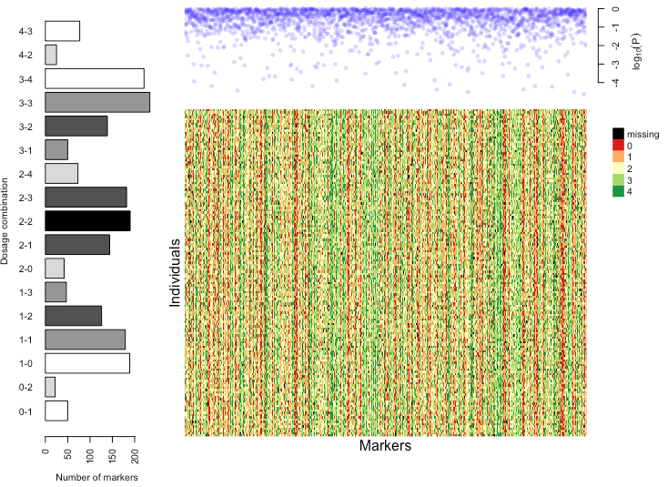
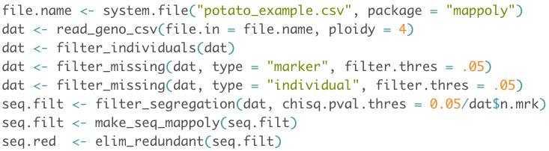
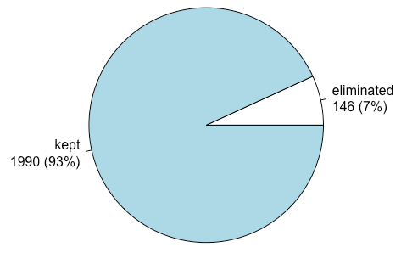
Input and quality control

Slide 5
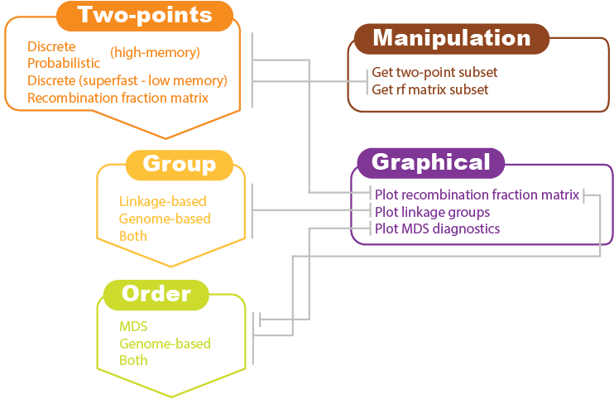
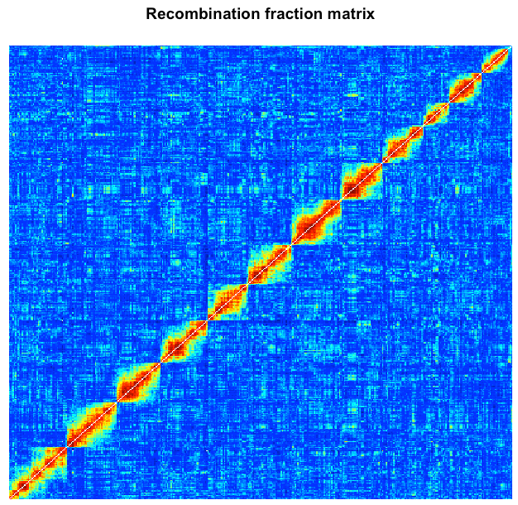
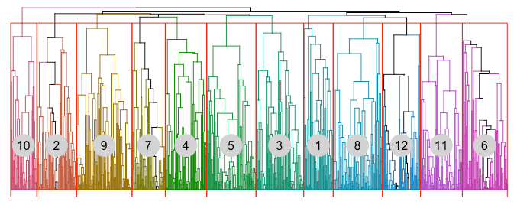
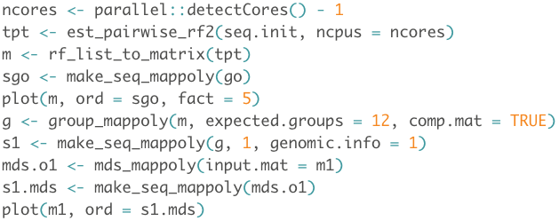
Two-points Rf calculation, grouping, and ordering

Slide 6
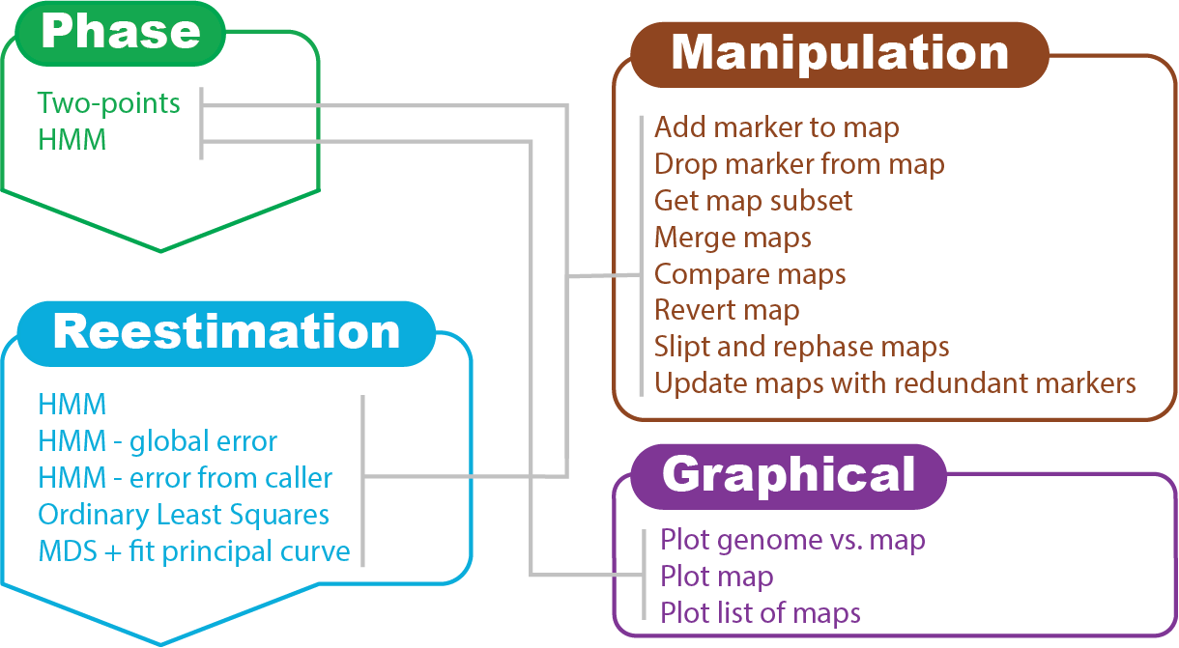
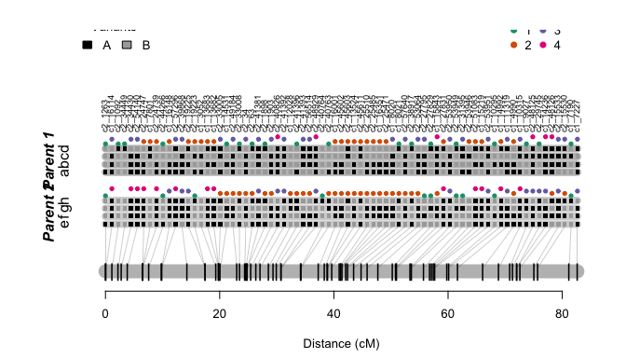
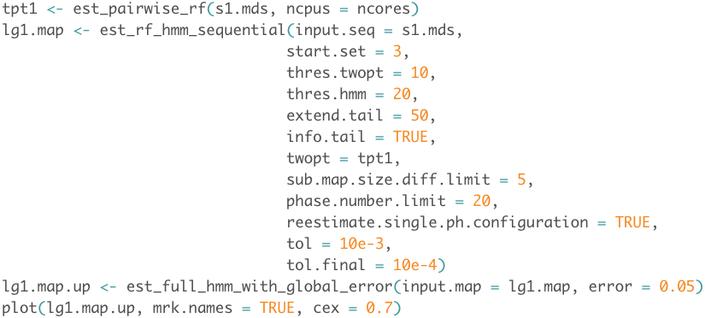
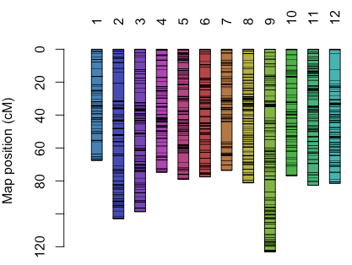
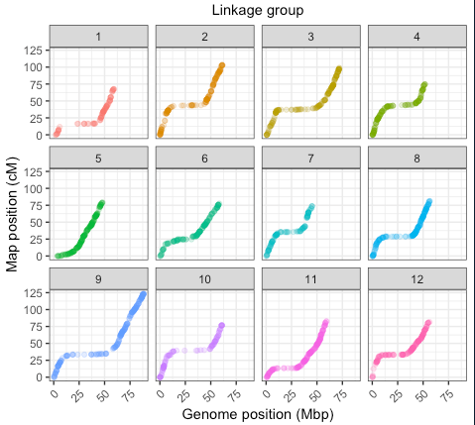
Phasing and multilocus re-estimation

Slide 7
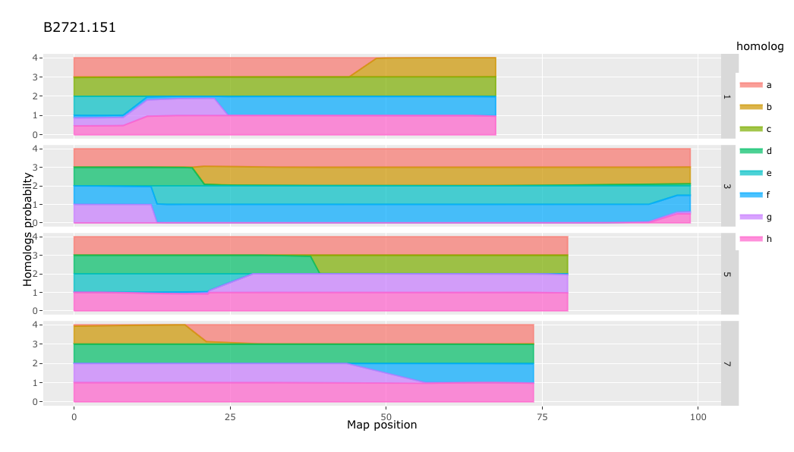
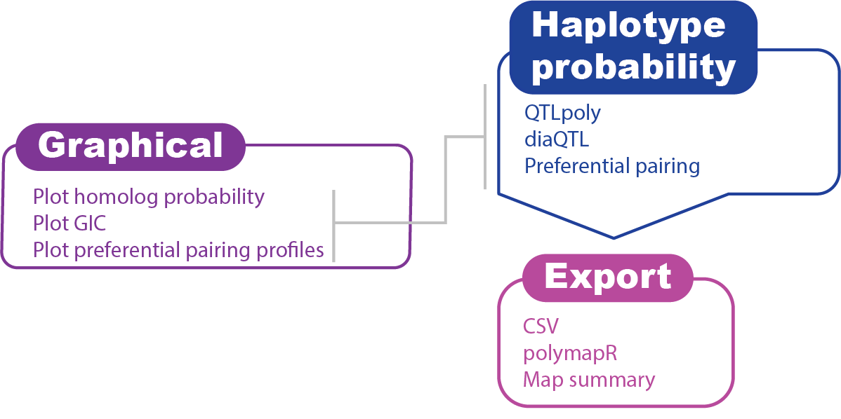
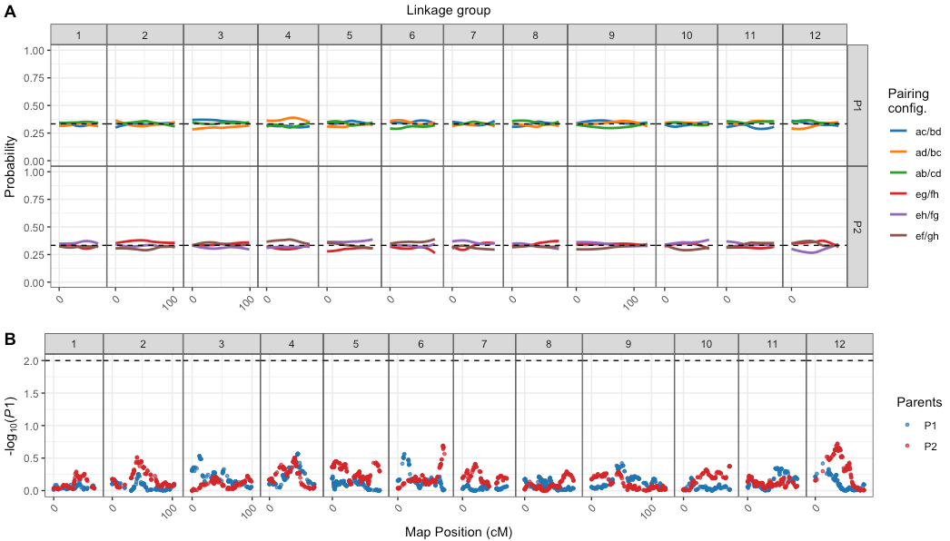
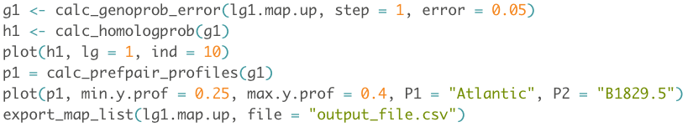
Haplotype probability and export

Slide 8
QTL mapping in polyploids
QTL mapping
- Genotypic variation → Phenotypic variation
- How to detect signals of those associations?
Polyploidy
Imposes challenges to genetic mapping
More alleles, many possible genotypes
Thus, many parameters to be estimated in the model

Slide 9
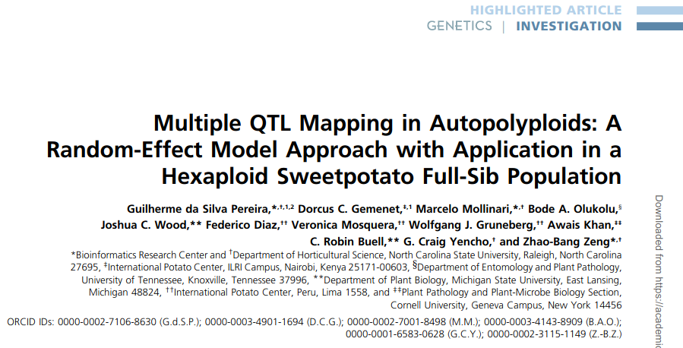
How to solve the n<<p problem?
Pereira et al., 2020. Multiple QTL Mapping in Autopolyploids: A Random-Effect Model Approach with Application in a Hexaploid Sweetpotato Full-Sib Population, Genetics, v. 215, 3.
https://doi.org/10.1534/genetics.120.303080

Slide 10
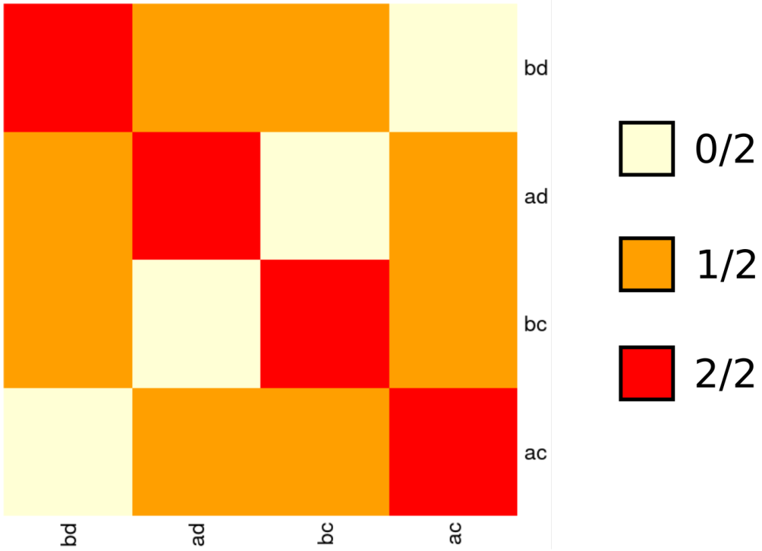
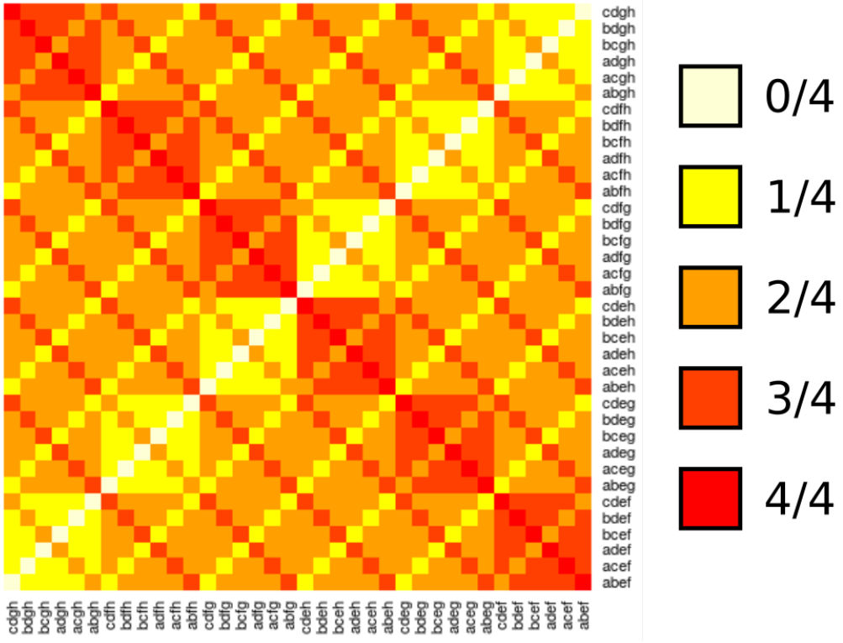
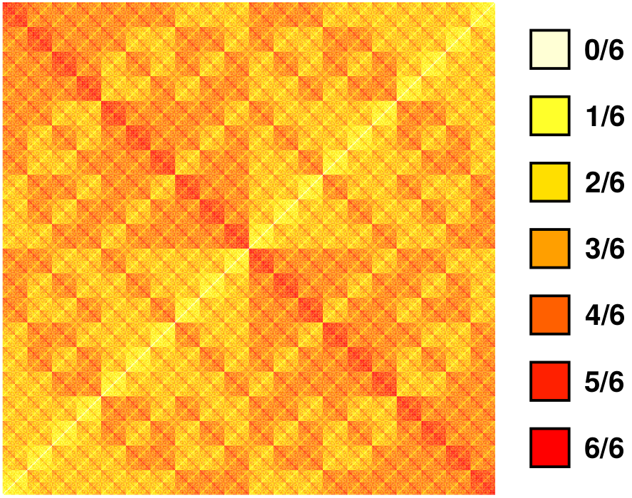
Expected relationship matrices
Expected genomic relationship matrix between full-sibs at any single genomic position
Diploid
Tetraploid
Hexaploid

Slide 11

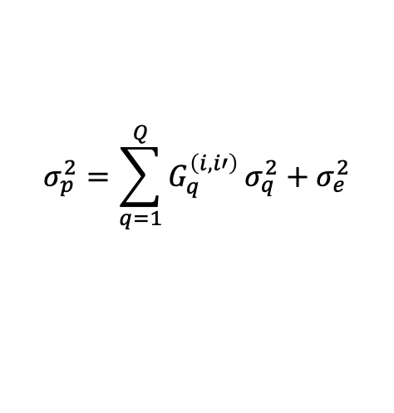
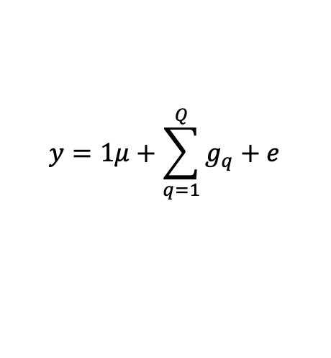
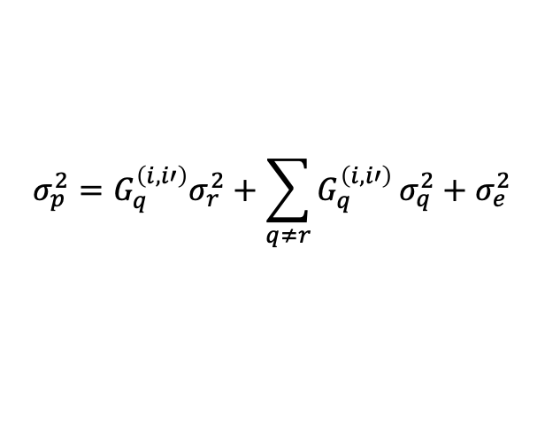
How to solve the n<<p problem?
Phenotypic data → mean and variance
Model selection algorithm:
1. A model starts with no QTL
2. Forward search adds one QTL at a time (if significant)
3. Model optimization:
3.1 Re-evaluate every QTL conditional to the others
3.2 Backward elimination of QTL with no significant effect
3.3 Position refining: updates QTL positions
$$y=1μ+\sum_{q=1}^{Q}{g_{q}}+e$$
$$σ_{p}^{2}=σ_{e}^{2}$$
$$σ_{p}^{2}=\sum_{q=1}^{Q}{G_{q}^{\left(i,i′\right)}}σ_{q}^{2}+σ_{e}^{2}$$
$$σ_{p}^{2}=G_{q}^{\left(i,i′\right)}σ_{r}^{2}+\sum_{q≠r}{G_{q}^{\left(i,i′\right)}}σ_{q}^{2}+σ_{e}^{2}$$

Slide 12
Perspectives
Extension to multi-parental populations
Multivariate QTL mapping
Integration with other model structures (model selection/GS)

Slide 13

Code demonstration
Download example files (SCRI repository)
https://github.com/mmollina/SCRI
Open
Install and load packages: mappoly and qtlpoly
Open the script: qtlpoly_startguide.R

Slide 14
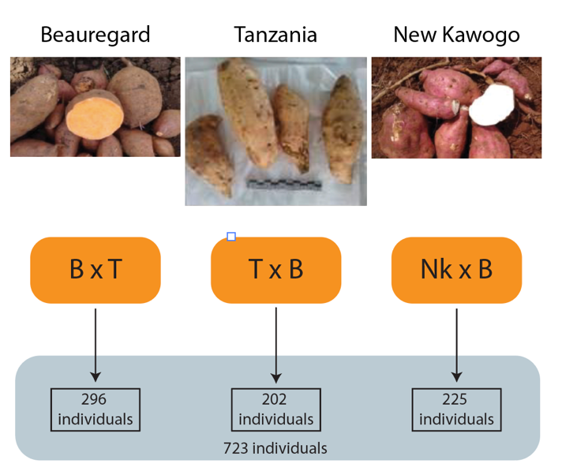
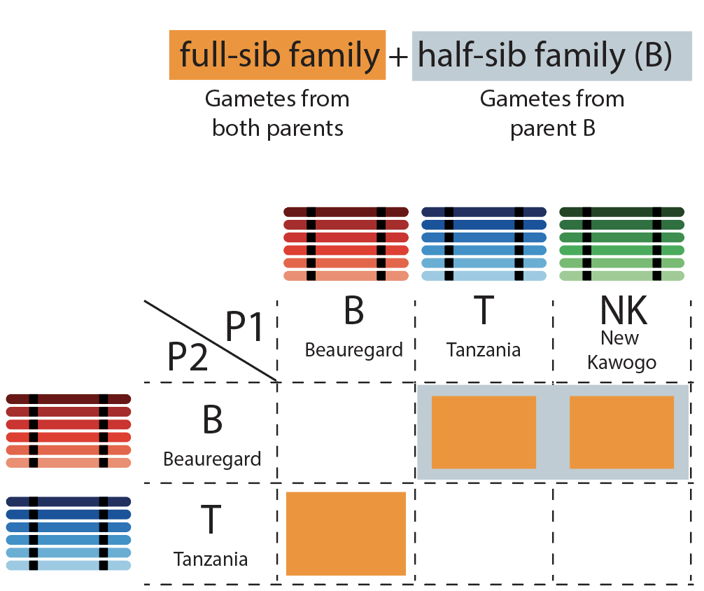

Case study: Three inter-connected hexaploid sweetpotato families
SweetGAINS project: Dr. Hugo Campos (CIP) and Dr. Craig Yencho (NCSU)
Parents: Beauregard, Tanzania and New Kawogo
Genotyping: GBS 28220 markers
Population: 723 individuals
Multiparental map based on connected families: can be used as input to PolyOrigin and other algorithms: will be available soon.

Slide 15
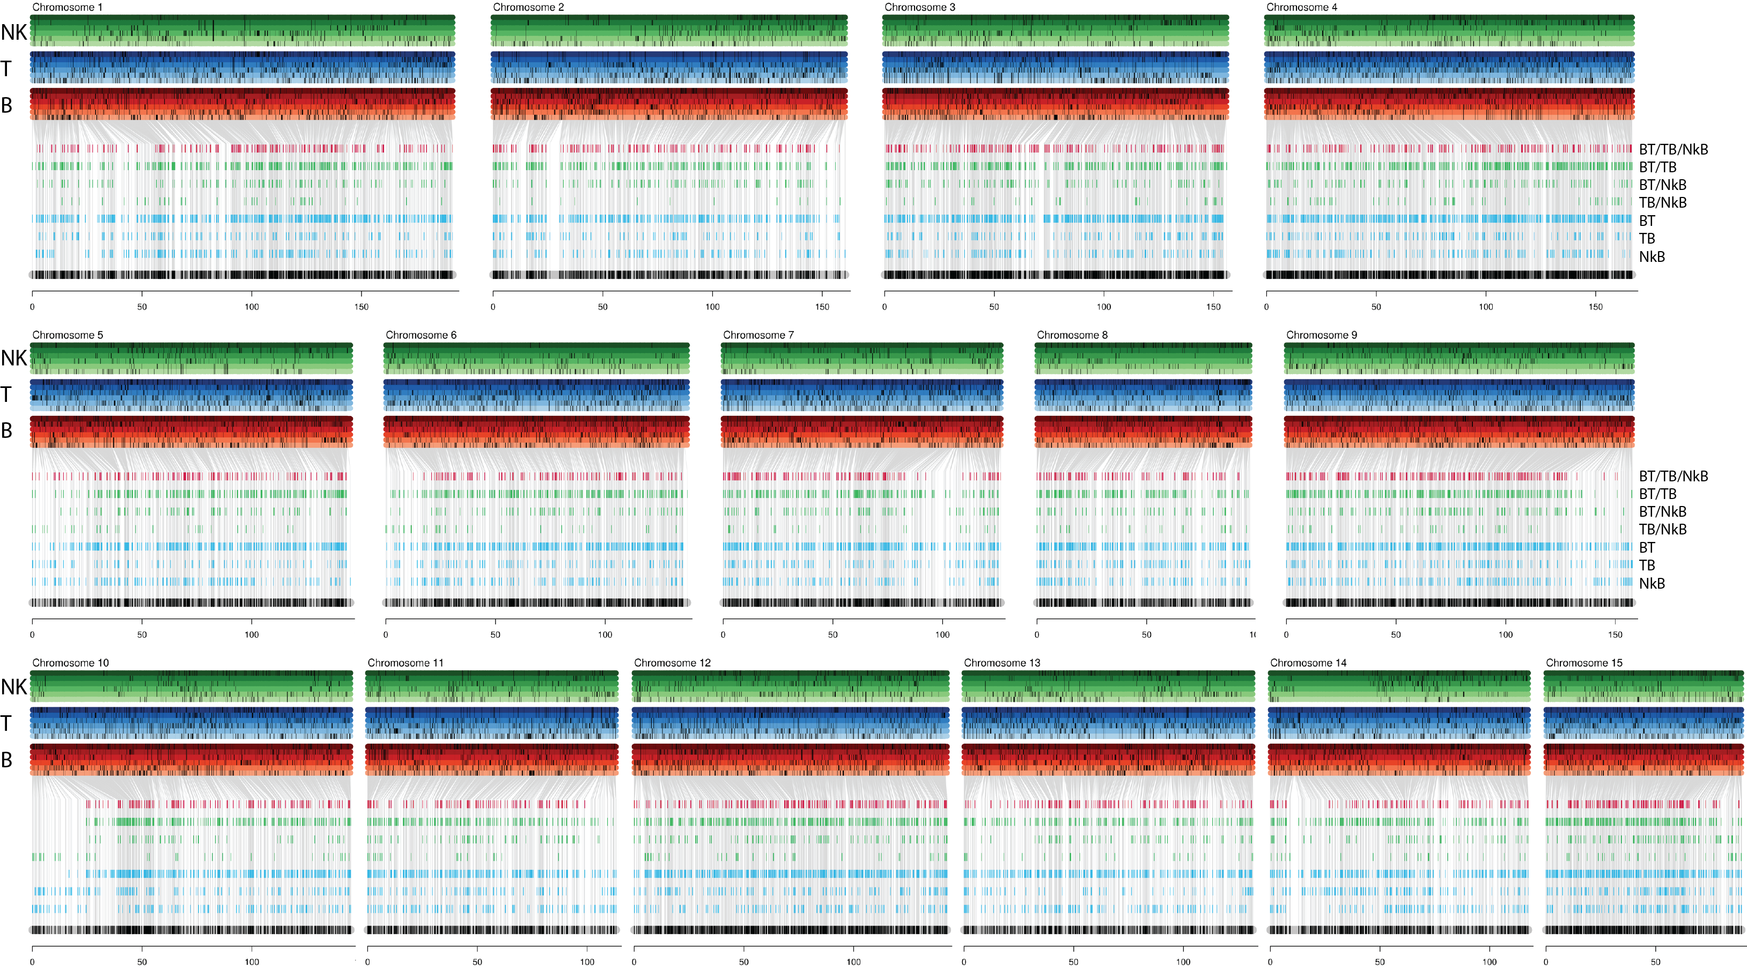
BT-TB-NKB genetic linkage map

Slide 16
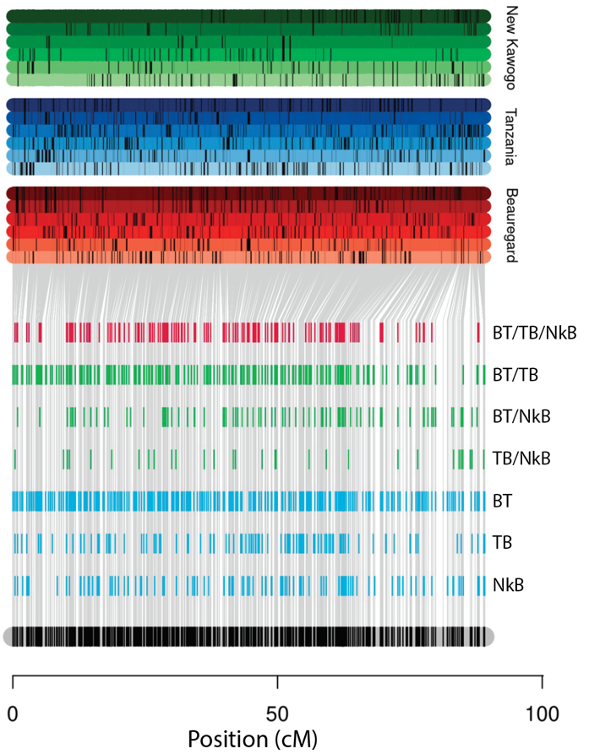
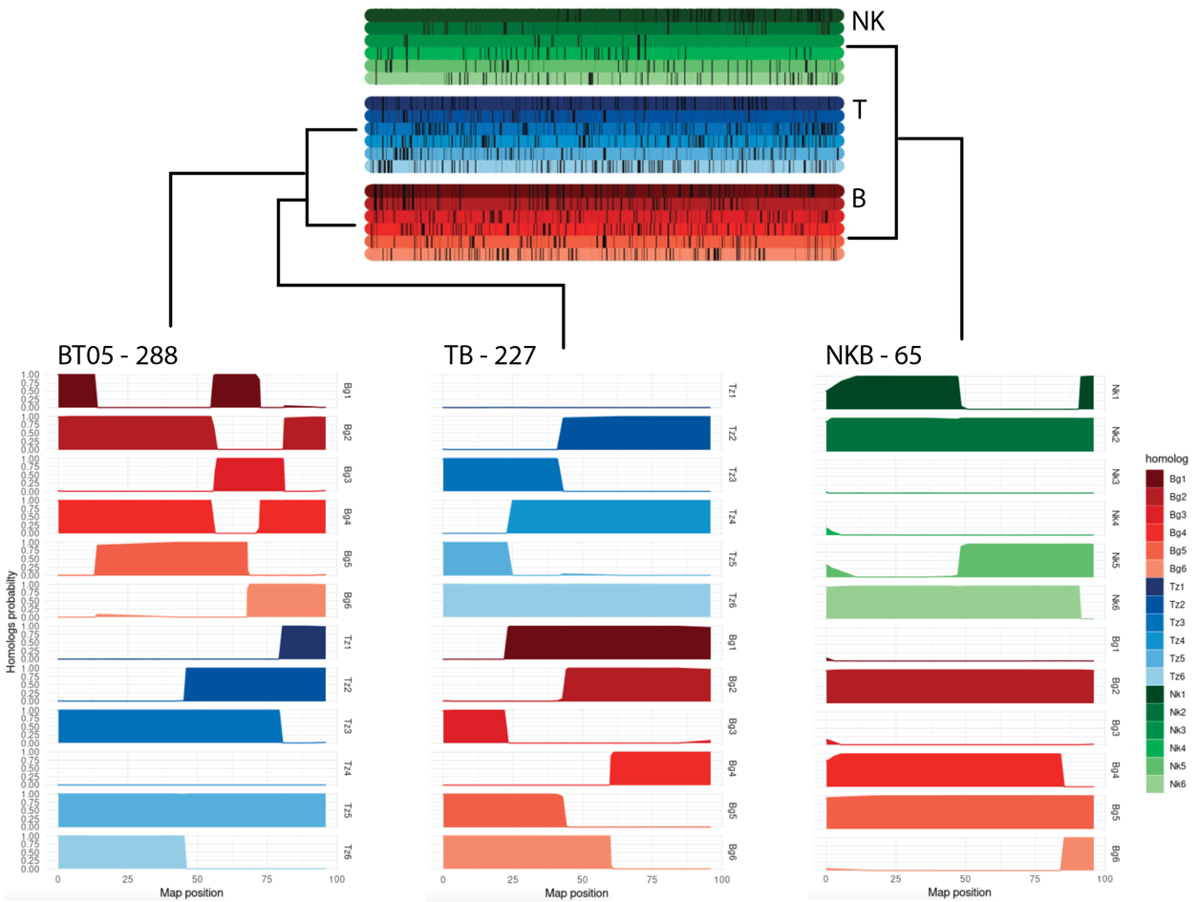
Haplotyping in BT-TB-NKB – Chromosome 15

Slide 17












Project Members

Slide 18























Other Collaborators
Neuhouse Farms
Woolf Roses L.L.C.

